Slide 1

Action research in software engineering
Kai Petersen
(kai.petersen@bth.se)

Slide 2
Outline
About Action Research
Experiences from two cases
Reflections and conclusions

Slide 3
Action research and schools of thought
Objective (independent from participants)
Subjective (constructed by participants)
quantitative
Positivist
Constructivist/Interpretivist
Quantitative +
qualitative
Experiment,
Survey,
Theoretical,
Mathematical reasoning
Case study
Pragmatist
Quantitative +
qualitative
Quantitative +
qualitative
Advocacy/Participatory
All
Software Eng.
Depends on what works at the time
Action research
Subjective truth, constructed by participants and observer

Slide 4
Action research
Characteristic | Description
Applied and practical | Focused on real-world problems (in this case challenges in software engineering)
Change focused | Interventions are introduced in the real-world and their effects are observed
Iterative process | Focused on feedback and learning with regard to changes made, evolution of the research solution
Participatory | Researcher active part of the process; Not research on practitioners, but rather with practitioners
In IS research: Lack of relevance was observed
Action research became relevant for IS to increase practical relevance
Notes:
Not always pure action research.

Slide 5
The action research cycle
Characteristic | Description
Diagnosing | Understanding challenges and problems
Action planning and design | Designing the “change” and planning the implementation
Action taking | Implementation of the action
Evaluation | Monitoring the effects and the implementation
Specifying learning | Explain the effects and take the learnings into consideration in the next iterations

Slide 6
Action research in software engineering
Glass et al. reviewed 369 papers and found no action research study (1995-1999)
Santos and Travassos identified only 16 action research studies
Topics studied with action research:
Database design
Architecture design
Process definition and improvement
Use case and scenario development
Design of measurement systems

Slide 7
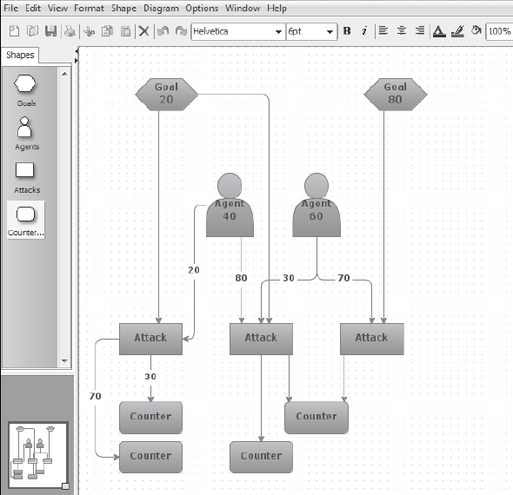
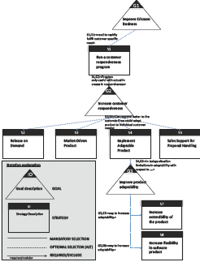
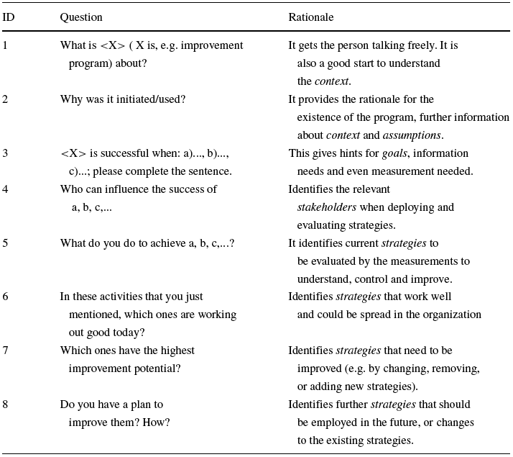
Experiences from action research in two industrial cases
Case 1: The development of a method for risk analysis (Countermeasure graphs)
Case 2: The development of an elicitation instrument to operationalize GQM+Strategies

Slide 8
Case 1: The Cycles
Notes:
Observe: Multiple cycles and stages
Multiple products
Shifted between products
First step is the diagnoses

Slide 9
Case 1: Model of collaboration
Researchers
Dejan Baca: Employment at the company = 100%
Kai Petersen: Employment at the company = 30%, Employment at the university = 70 %
Practitioners: Members of the risk analysis team
During the cycles from “Prototype” to “Expansion” researchers were moderators/drivers
Researchers as members of the team during the last cycle “Ways of working”
During the research project the researchers never became inactive observers

Slide 10
Case 1: Data collection
Journal documenting our reflections
Work products (risk analyses) – quantitative and tangible data
Feedback from practitioners

Slide 11

Case 1: The Cycles: Diagnosis
Observation: In current risk analyses we find security threats, but only of low severity (in terms of damage and likelihood of occurrence).
Method: Peltier grid
Reason: Starts with the threats directly, does not drive non-security experts thinking in the sense of goals of attackers, etc.

Slide 12
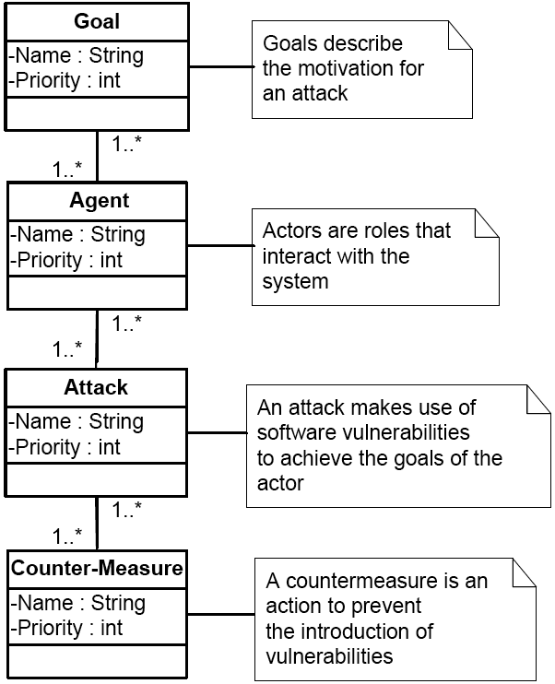
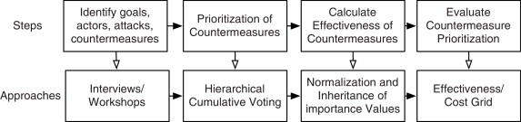
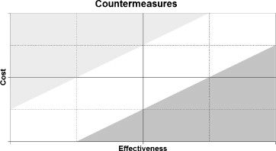
Case 1: The Cycles: Prototype (solution)
Model
Process
Output

Slide 13
Case 1: The Cycles: Prototype (solution) Cont.
Action planning and taking
Two pilot risk analyses
Post-it notes used
Researchers are moderators and drive the risk analyses
Evaluation
Approach identified high level threats
A large number of countermeasures were identified
The need for tool support was identified, a restructuring in the structure should be done to be more intuitive (connect goals and agents directly to an attack)

Slide 14
Case 1: The Cycles: Redesign
Action planning and taking
Apply risk analysis to new features instead of legacy
Provided the implemented tool
Evaluation
Practitioners identified additional threats
Found it easy to integrate them into the existing analysis
Could evaluate countermeasure scenarios (unforeseen benefit)

Slide 15
Case 1: The Cycles: Expansion
Action planning and taking
Countermeasure graphs worked as intended
Minor improvements to the tool (grouping, disable legacy information from the graphs, etc.)
Evaluation
High reusability of information between products (reuse of risk analyses)
Startup-time for Product C much lower

Slide 16
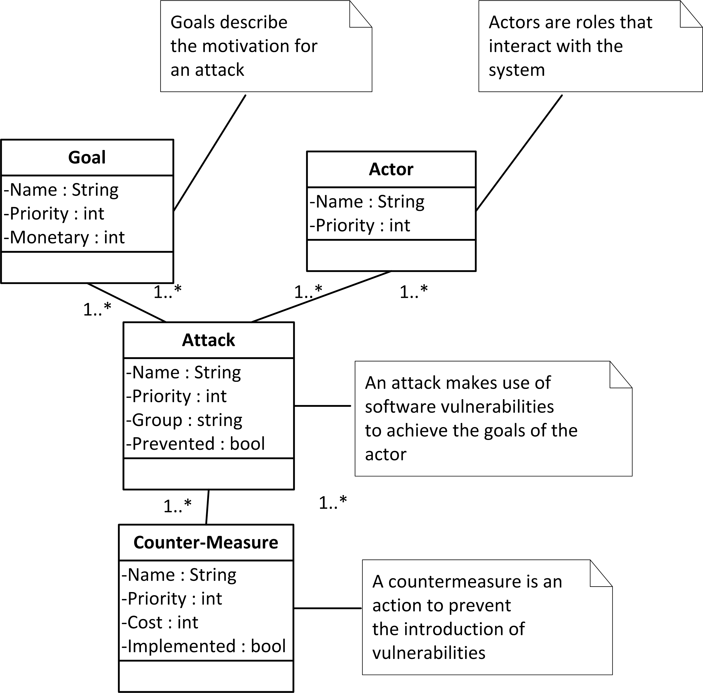
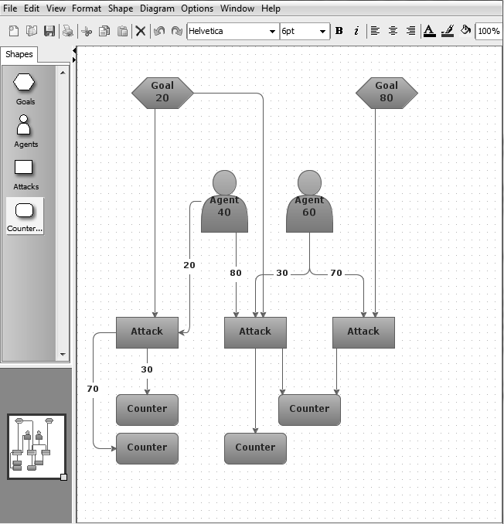
Case 1: The Cycles: Ways of working
Action planning and taking
Add another product not involved with the method + tool yet
Evaluation
No new or major changes were introduced
Minor additions in the functionalities (add definitions, show current state of security level based on open/mitigated threats)
Tool
Model
Process
Visualization

Slide 17
Experiences from action research in two industrial cases
Case 1: The development of a method for risk analysis (Countermeasure graphs)
Case 2: The development of an elicitation instrument to operationalize GQM+Strategies

Slide 18
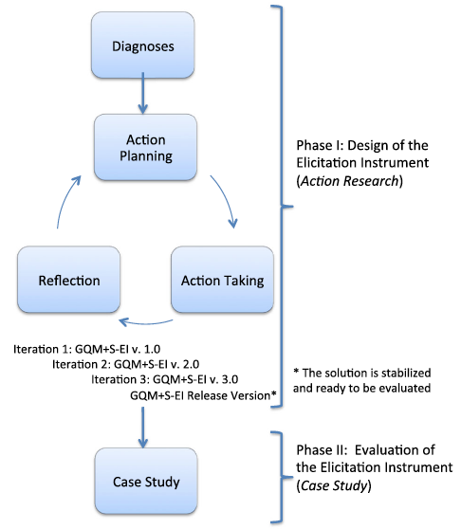
Case 2: The Cycles

Slide 19
Case 2: Model of collaboration
Researchers (during the action research cycle)
Negin Asghari: Lead interviewer following the guidelines (100 % at the company during the research project)
Cigdem Gencel: Support to ask follow-up questions (100 % at the university)
Kai Petersen: Documentation and providing summaries in-between (30 % employment at the company, 70 % at the university)
Practitioners: Two practitioners acted as observers during the activity, and later (primarily during the case study) took the role of facilitators
Set up a steering group from the company
Principle: Knowledge transfer through switching roles
Early cycles: Practitioners primary observers, researchers active facilitators
Later cycles: Researchers primary observers, practitioners active facilitators

Slide 20
Case 2: Data collection
Documentation during the workshop, visible to the practitioners on the screen (i.e. could see how they were understood in “real-time”).
Field-notes and journals
Right after each session using the elicitation instrument, we recorded our discussion/reflections to plan for the next iteration
Reflections were transcribed and systematically analyzed

Slide 21
Case 2: The Cycles

Slide 22
Case 2: The cycles: Diagnosing
Current status: Company started use of ISO/IEC 15939 to define measurements
Organizational Goal: Define a standard measurement process to be used in the organization
Need for elicitation was apparent
History of working with measurement programs run in different ways

Slide 23
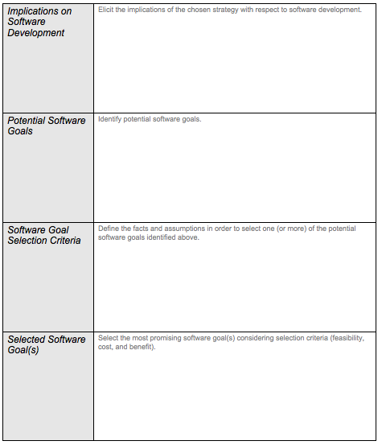
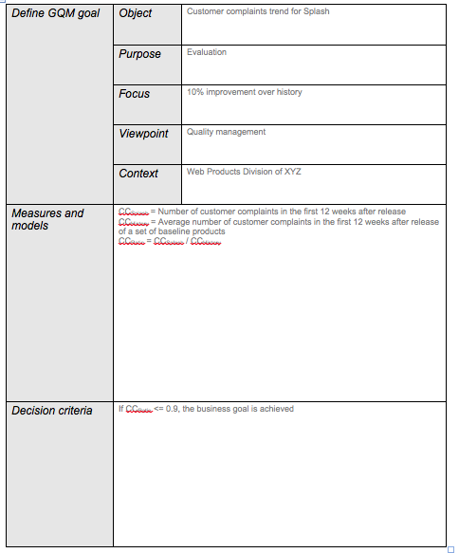
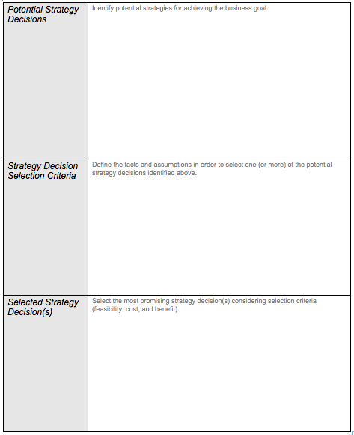
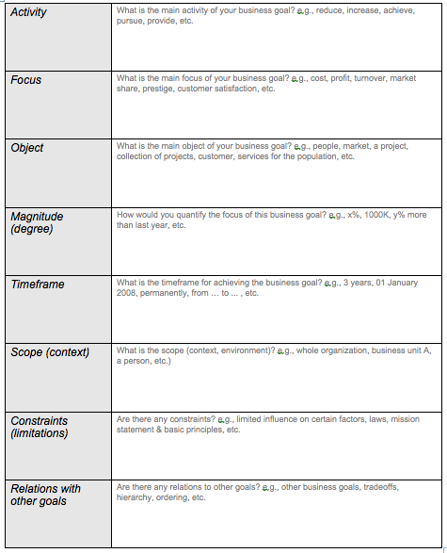
Case 2: The cycles: GQM+S-EI v 1.0
Action taking
Evaluation:
Too much information;
No relationships; Need to
be measurement expert
to answer
Evaluation:
Terminology created confusion as concepts meant different things to different people;
Notation restricted people in expressing themselves freely; Communication took a long time;

Slide 24
Case 2: The cycles: GQM+S-EI v 2.0
Action planning and taking:
Semi-structured questionnaire as a solution
Q1: What is X about? (gets the person talking freely, good start to understand)
Q2: Why was it initiated? (provides the rationale)
Q3: The customer responsiveness program is successful when (gives hints for information needs and even measurements needed):
…..
Q4: Who can influence the success of a, b, c, d, e, f… (identifies stakeholders)
Q5: What do you do to achieve a, b, c? (identifies key actions to be evaluated by the measurements)
Q6: In these activities that you just mentioned, which ones are working out good today? (obtain info about current state/baseline)
Q7: Which ones have the highest improvement potential? (obtain info about desired improvement areas)
Q8: How can we improve them? (identify improvement actions, would like to know the effect of these actions through measurements)
Evaluation:
Interviewee more comfortable;
More information captured faster;
Capturing information on white-board
cumbersome and cannot be done efficiently when distributed

Slide 25
Case 2: The cycles: GQM+S-EI v 3.0
Action planning and taking
Elicitation instrument works as intended
Mind-map tool used with live documentation
Scribe paces the elicitation
Evaluation
No loss of information
Easy navigation and “live” member checking
Release version complemented with guideline descriptions

Slide 26
“Case study”
Goal: Evaluate the designed instrument in a larger scale on a different improvement program
Accuracy: Do we have the “correct” measures
Completeness: Do we have “all” relevant measures

Slide 27
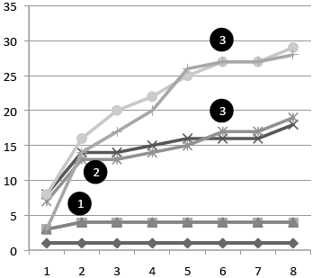
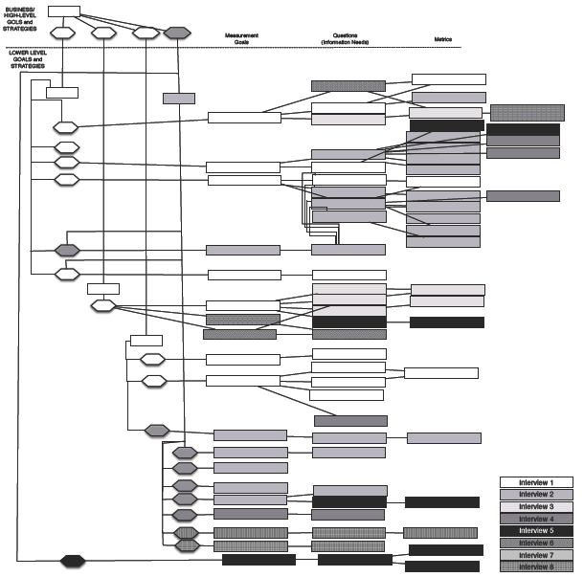
Case study: results
Accuracy: Only minor modifications in formulation, overall perceived as accurate by interviewees and steering group
No modification in structure, or addition/deletion of elements
Completeness: saturation in information needs, metrics, and measurement goals

Slide 28
Main case study results

Slide 29
Conclusions for practice
Evolutionary versus revolutionary results
Redesign due to failure may lead to creative results
Process comes naturally to practice (iterative way of working, process improvement)
Switch roles (researchers and practitioners switch observer/actor roles)
Interesting model for co-production to be documented for funding agencies
Employ researchers at least partially
Notes:
Failure interesting as it allows to explain why, if the why explanation has been correctly identified, then we are most likely more successful in the next iteration.

Slide 30
Conclusions for research
To increase reliability, include multiple researchers and record information carefully
The main challenge from a research perspective is bias
No clear distinction between research methods case study and action research, a bit of both (grey zone)
Report cycles and learning from each cycle
When possible, switch contexts

